Slide 1
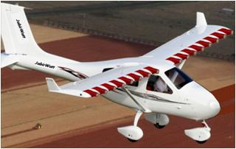
Electric Air Vehicle Performance Prospects: Comparing eVTOL versus USTOL
David G. Ullman
Emeritus Professor Oregon State University
ullman@davidullman.com
Notes:
Is this dream a potential reality
EYE CONTACT

Slide 2
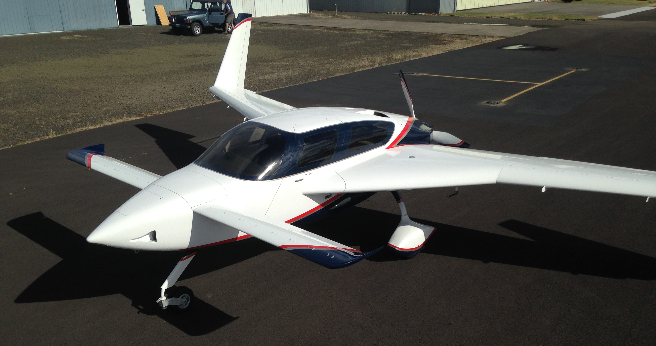
My background
BS and MS in aerospace engineering (1960s)
Transonic wind tunnel work for the Navy (1960s)
Air Force Flight Dynamics lab (1970s)
Emeritus Professor of product design (1980-2005)
Text “The Mechanical Design Process” 6th edition
Life Fellow ASME
Built two general aviation airplanes
Electric airplane design (2009- present)
Notes:
Research while Professor funded by NSF, DARPA, JPL and others
Taught by Wilbur Wright

Slide 3
Airplane Design Publications
2009: “Hear the Hum? An Electric Airplane May Be Coming Soon To An Airport Near You” KITPLANES
2010: “The Electric Powered Aircraft: Technical Challenges” EAA Experimenter.
2015: “Using Vortex Generators to Enhance Pusher Aircraft Cooling” KITPLANES
2017: “Comparing Electric Sky Taxi Visions”
With contributions from Pat Horgan of CubCrafters, Richard Ouellette of Boeing Commercial and Vincent Homer
Available at www.davidullman.com/aeronautics
Notes:
Vince's work Funded by CCW

Slide 4
In 2015 Vincent Homer and I began to study USTOL potential
Between us we have nearly 100 years of experience in engineering, aeronautics, and making things work
Vince did wind tunnel research funded by Custer Channel Wings in 1970
We have a patent application in process
We are totally self funded

Slide 5
Goals
Develop an analytical model to compare rotor-craft, eVTOL, and USTOL
Introduce concept of USTOL (Ultra- STOL)
Inputs: Vehicle class, Number of passengers, Battery capabilities
Outputs: Range, Power required, Vehicle cost
Make the case that USTOL has great potential in spite of current focus on rotor-craft and eVTOL.
Give a peek at our USTOL work

Slide 6
"If everyone is thinking alike, then no one is thinking." Benjamin Franklin

Slide 7
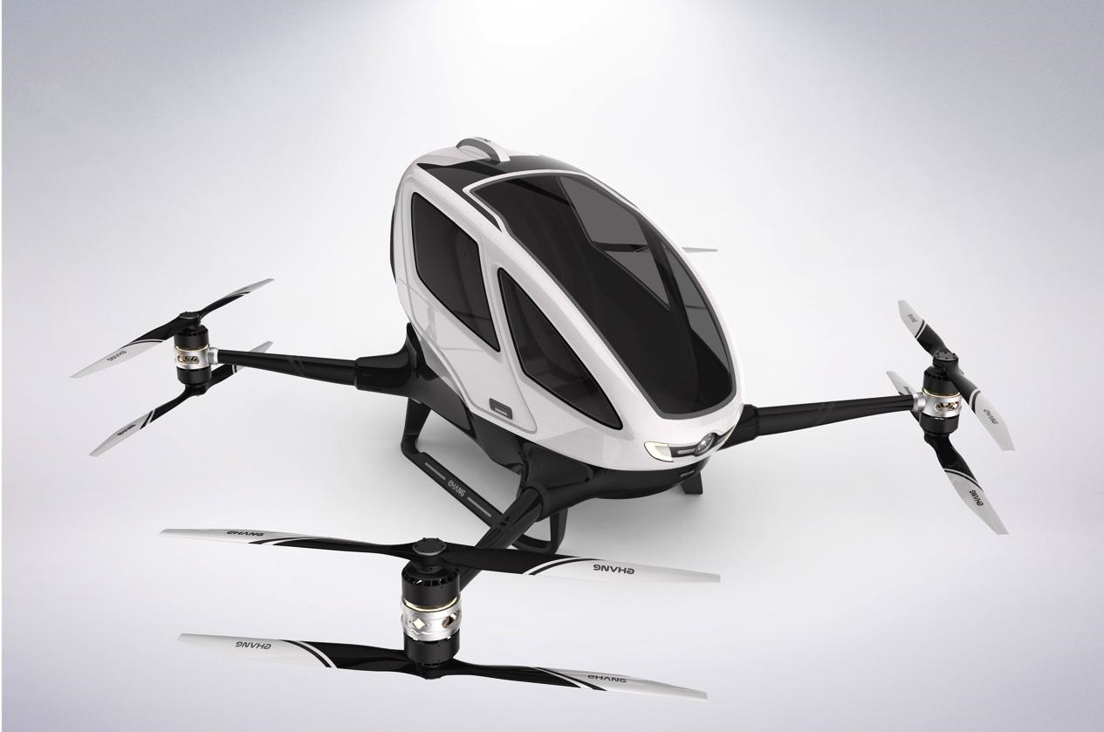
Classes of Aircraft Considered
eVTOL
USTOL
Rotor-Craft

Slide 8
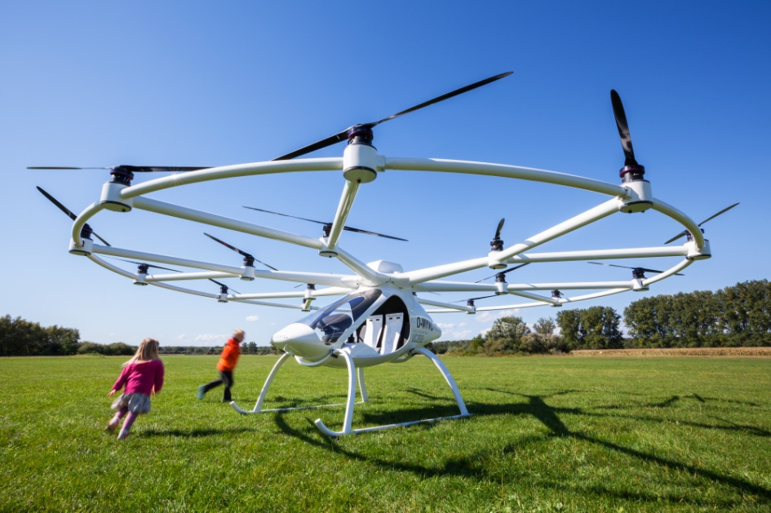
Rotor-craft include multi-copters and helicopters
EPSAROD: Robinson R44 helicopter modified for a single electric motor

Slide 9
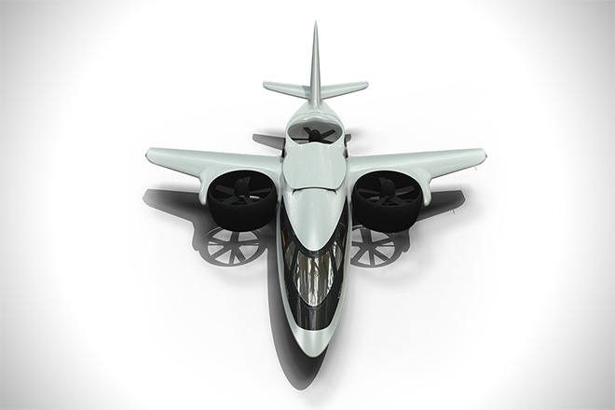
eVTOL: aircraft that take-off vertically and then transition to winged flight before transitioning again to a vertical mode for landing.
TriFan 600
Lillium
Notes:
TriFan is hybrid.

Slide 10
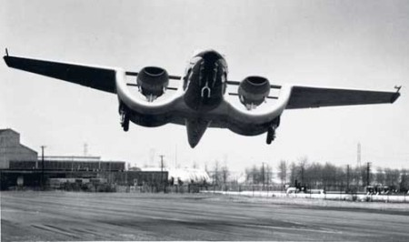
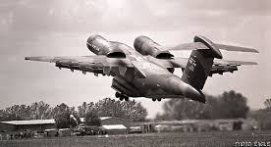
Ultra Short Take-Off and Landing (USTOL): winged aircraft that uses Distributed Electric Propulsion (DEP) to create Propulsion Airframe Interaction (PAI) enabling short distance take offs and landings while providing very efficient cruise potential. Descended from the Custer Channel Wing, Boeing YC-14 and others
Notes:
Custer started in the 1930s.

Slide 11
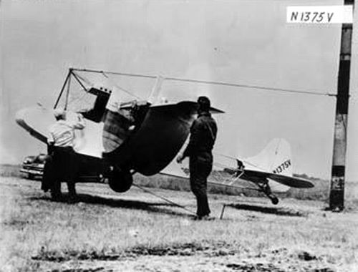
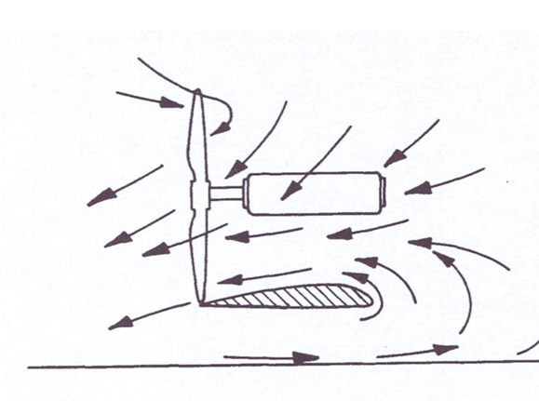
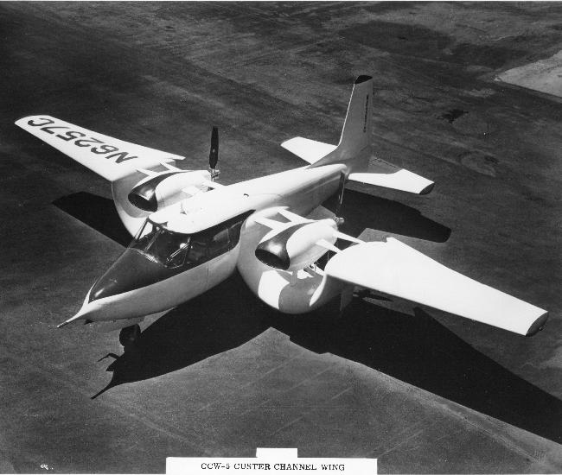
Custer Channel Wing
"It's the speed of the air, not the airspeed."

Slide 12
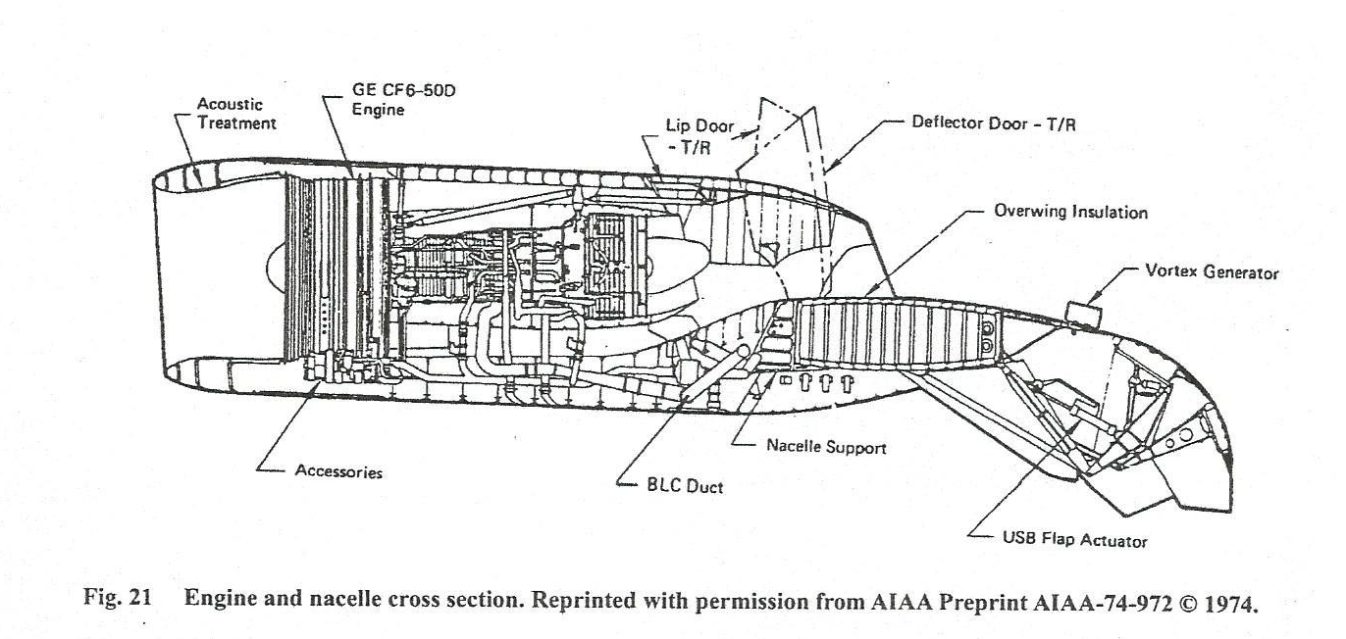
YC-14 used Upper Surface Blowing (USB) to achieve high Lift Coefficients
Notes:
Engine out issues

Slide 13
USTOL is electric STOL that can perform like Lil’ Cub
Take off 14’ 7” (4.4m)
Landing 10’ 5” (3.2m)
Total score of 25’ (7.6m)
Limitations as PAV
Cruise speed
Attitude
Weight
Power required – noise
Pilot skill
This is BF-STOL
Brute Force-STOL
Notes:
Done with very high power to weight ratio, very low weight, high lift devices on the wing, perfect flying conditions and extreme pilot skill. But still this is better than most helicopters!!!

Slide 14
STOL Performance by Manufactured Aircraft
Carbon Cub SS (CubCrafters Inc.)
Gross weight for bare airframe and pilot (1092 lbs - 500kg)
180 hp (130 Kw)
TO at 32 mph, 27 kts (Vs0)
Cl = 1.4
Area = 179 sq ft (16.6 m²)
In public competition, a stock CubCrafters Carbon Cub aircraft demonstrated a 60 ft takeoff and 53 ft landing.

Slide 15
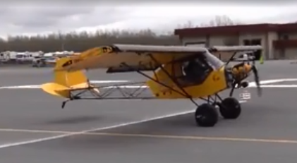
Take-Off Distance
S_{g} = $\frac{13 ∗\frac{W}{A}}{\frac{T}{W}∗CLTO}$
@ sea level
Shorten Take-off distance by:
Lowering the wing loading (W/A)
Penalty during cruise due to increased form drag
Raising the thrust to weight ratio (T/W)
Penalty in requiring larger engine or motor
Raise the take-off lift coefficient CL_{TO}
Lil’ Cub has:
Large wing
Low weight
High thrust
Medium CL by blasting propwash on underside of the wing

Slide 16
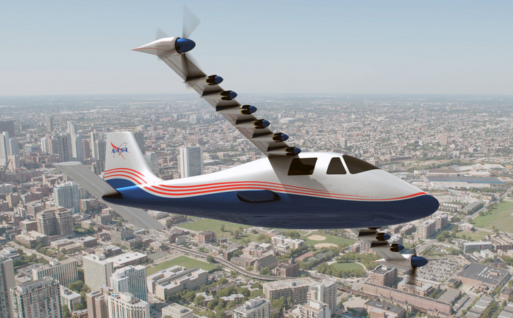
NASA X-57 Maxwell is not really USTOL but does take advantage of Propulsion Airframe Interaction (PAI) to leverage Distributed Electric Propulsion (DEP).
Notes:
Not using PAI in cruise

Slide 17
Propulsion Airframe Interaction (PAI)
Distributed Electric Propulsion (DEP)
Upper Surface Blowing (USB)
?????
Ultra STOL
(USTOL)
Electric Ducted Fans (EDF)
Integrated Distributed Electric-Augmented Lift (IDEAL)

Slide 18
IDEAL: Integrated Distributed Electric-Augmented Lift
Use multiple Electric Ducted Fans mounted so they increase the air velocity over the top surface of the wing
Takeoff
Take-off CL > 5
Cruise
L/D max > 20
Notes:
L/D max o stock plane about 16

Slide 19
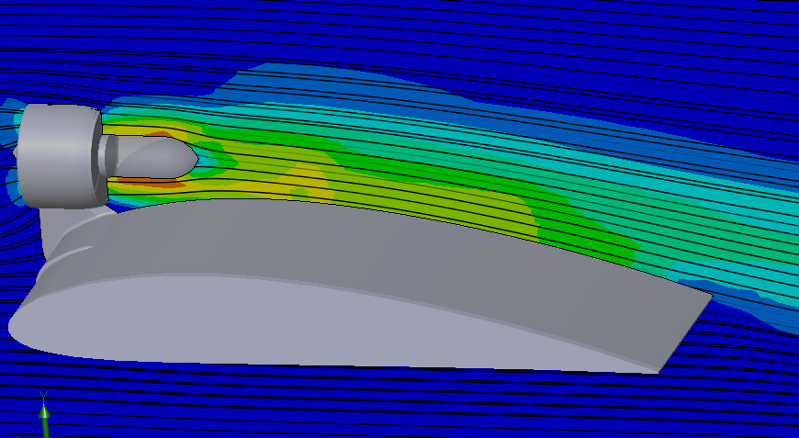
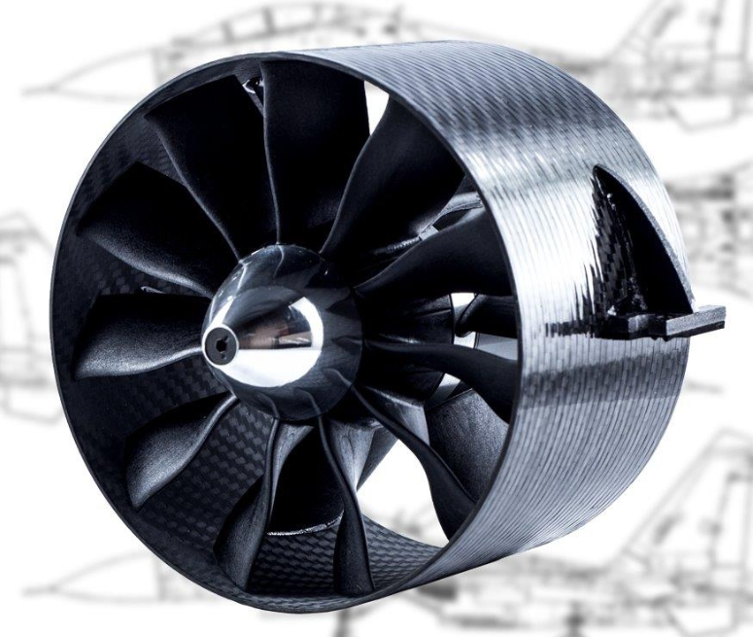
Basic concept of IDEAL
The speed of the air over the top surface determines 80% of the lift generated by a wing.
Spreading the high velocity air from EDFs propulsors over the upper surface gives dramatic benefits.

Slide 20
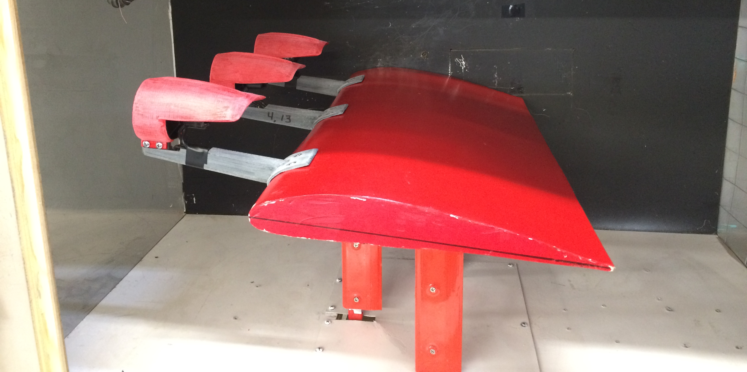
An example IDEAL configuration in our wind tunnel

Slide 21
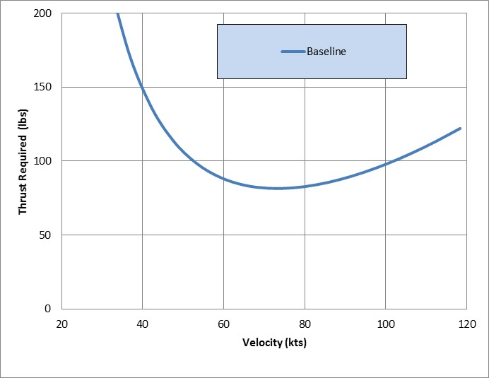
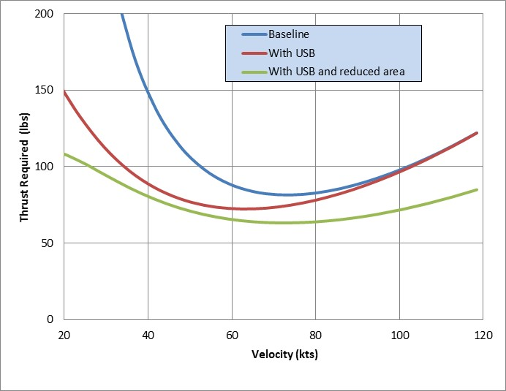
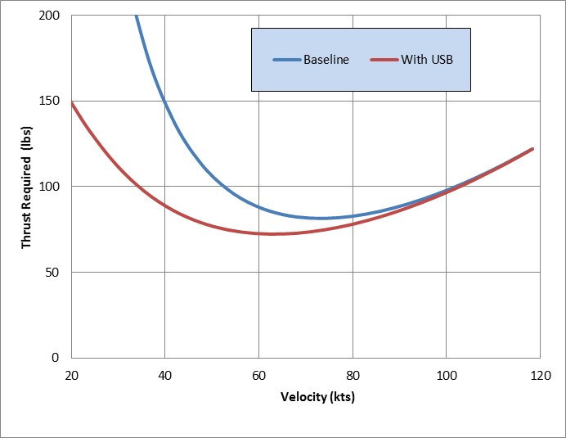
Notes:
Induced drag, form drag

Slide 22
Analytical Model Basics
The model is designed to identify:
Maximum range
Gross weight
Needed thrust
Needed power
Cost per vehicle
The model is driven by:
Aircraft class (rotor-craft, eVTOL, USTOL)
Battery energy density
The battery energy stored in kilowatt hours
The number of occupants
The model is based on Breguet’s Range Equation modified for electric vehicles. Others have done similar (Mark Hepperle, and Rob McDonald and Brian German).

Slide 23
Batteries characterized by energy density (ρ_{b}) and energy capacity (Ec)
Three levels of deliverable energy density are considered:
Current Reality - 150 wh/kg (C)
Near Future - 300 wh/kg (NF)
Far future possibility - 450 wh/kg (FF)
Energy Capacity (Ec) = Battery Weight (Wb) * Energy Density (ρb) * Percent Deliverable.
Note: hybrids not included in this study
Notes:
No hybrids. Near future? Far future??

Slide 24
Model is based on weight fractions
Airframe Weight Fraction
+
Passenger Weight Fraction
+
Battery Weight Fraction
= 1.0
Airframe + motors and controllers = 55%
Based on passenger and luggage weight 100/220 (kg/lb)
“passenger” = any occupant of the aircraft
Taxi and take-off (for USTOL)
Hover during take-off and landing (for eVTOL and rotor-craft)
Climb
Cruise
Descent
Reserve

Slide 25
Assumptions
Cruise velocity (mph/fps/kts) =150/220/130
Cruise altitude (ft/m) AGL = 1000/305
Time to climb, based on 500 ft/min climb rate = 2 minutes
Electrical and propulsor efficiency = 0.76
Propulsor efficiency = 0.85 for cruise and climb and an electrical system efficiency = 0.9.
The assumptions used in the model closely follow those used by Rob McDonald and Brian German, “eVTOL Stored Energy Overview”, UBER Summit, April 2017.

Slide 26
Assumptions
Figure Of Merit = 0.63 (rotor-craft and eVTOLs) The ratio of the ideal power required to hover over the actual. FOM = .7 corrected for 90% electrical system efficiency.
Hover time (sec) = 60 (rotor-craft and eVTOLs)
Reserve time (min) = 10
Violates FAR Part 91 Section 151: 30 minutes reserve for VFR day flights
Percent battery capacity available = 80%
This is value used by McDonald and German. However, there is evidence that the reality is closer to 60% with 20% off the top for battery life and 20% off the bottom for safety.

Slide 27
Assumptions by class
Class | L/D Climb | L/D Cruise | Disk Loading (lb/ft²) | Thrust /weight Ratio
Rotor | 4.25 | 4.25 | 4.5 | 1.25
eVTOL | 7.5 | 10 | 15 | 1.25
USTOL | 17.5 | 15 | NA | 0.34

Slide 29
Model verification EPSAROD: Robinson R44 helicopter modified for a single electric motor
Specs
183 kw electric motor
100 amp-hrs at 700 volts, so 70 kwh
Energy density 140 wh/kg
1 occupant
65kts (it varied)
Cruised for 30 min
By adjusting airframe weight fraction to 36% and with no reserve
 | Actual | Model
Gross weight (lb/kg) | 2500/ 1136 | 2492/ 1132
Battery weight (lb/kg) | 1100/ 550 | 1182/ 537
Cruise time (min) | 30 | 35
Disclaimer: All data shown here is based on incomplete information.
Notes:
Model verification. No other data available.

Slide 30
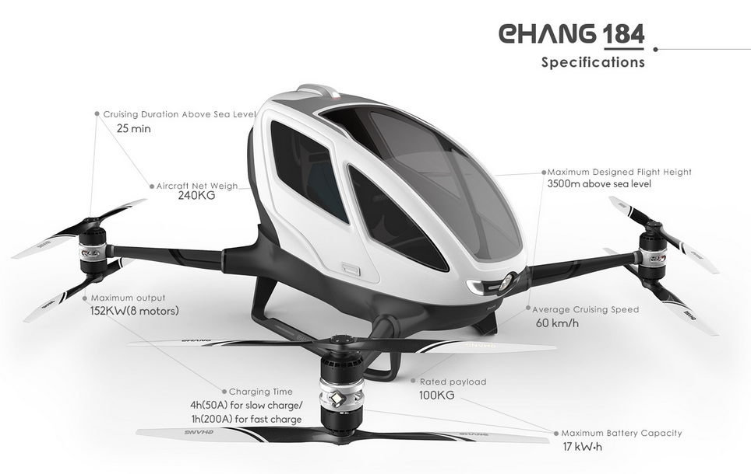
eHang
14 kwh current batteries
Single passenger (100 kg)
Assume Airframe fraction 35%
Range 37 miles (60 km)with no reserve
Range 12 miles (19 km) with 10 min reserve
eVolo
8 kwh current batteries
1.8 passengers
Assume Airframe fraction 45%
Range 17 miles (27 km)with no reserve
Range -8 miles with 10 min reserve
Disclaimer: All data shown here is based on incomplete information.

Slide 31
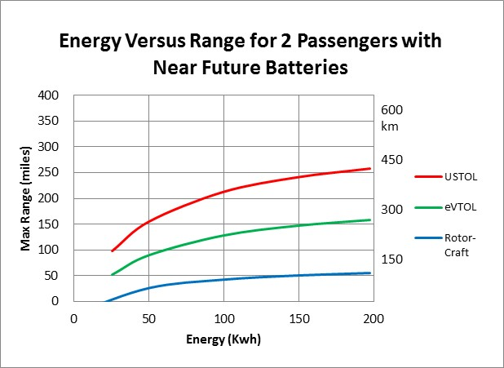
200 Kwh near future battery requires 1826 lb (830kg) battery in a 5000 lb (2270kg) machine
200 Kwh near future battery will cost an estimated $20,000

Slide 32
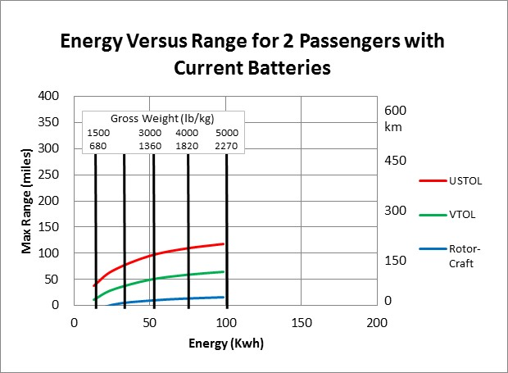
Tesla Model S with large battery
Notes:
Rotor-craft have a range of 15 miles (24 km) Graph stops at 100 kwh as this is a 5000 lb machine regardless of class.
eVTOLs will have range of less than 65 miles (100km) with 5000 lb (2272 kg) aircraft and require very high thrust and power.
USTOLs can achieve 116 miles (186 km).

Slide 34
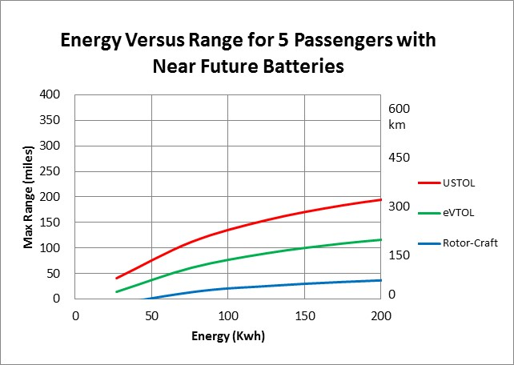
200 Kwh near future battery requires 1826 lb (830kg) battery in a 6500 lb (3000kg) machine

Slide 35
200 Kwh near future battery requires 1826 lb (830kg) battery in a 6000 lb (2700kg) machine
50 Kwh near future battery requires 470 lb (214kg) battery in a 3000 lb (1350kg) machine

Slide 36
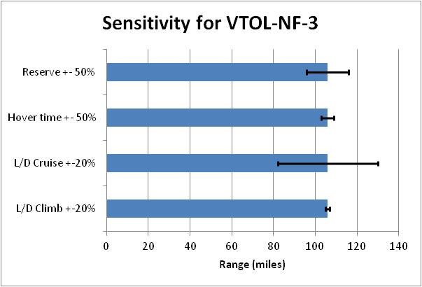

Slide 37
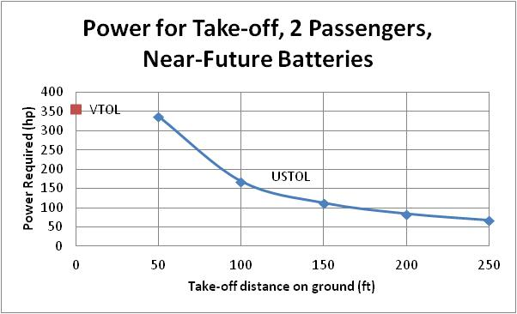
USTOL has nearly twice the range as the comparable eVTOL

Slide 38
Takeaway #1
Rotor-craft may evolve into usable short distance PAVs, but regardless of battery evolution, they will always be severely range limited unless they go hybrid.

Slide 39
Takeaway #2
eVTOLs can be developed into short or mid-range vehicles, but they will be large, may require hybrid systems and high power.

Slide 40
Takeaway #3
USTOLs have the potential to be a good mid to long range electric air vehicle solution.
Regardless of mission USTOLs require about 1/3 the energy as eVTOLs!
Depending on take-off distance, USTOLs require much less power than eVTOLs.
Notes:
Where the UBER sidewalk ends

Slide 41
Takeaway #4
PAI (Propulsion Airframe Interaction) is under-studied in the current PAV frenzy. Most rotor-craft and eVTOLs use brute force where there might be more subtle solutions leading to great energy savings and power/noise reduction.
The IDEAL project uses DEP with EDFs leveraging PAI to achieve USTOL.
Notes:
Lillium is an exception

Slide 42
IDEAL Wind Tunnel Testing

Slide 43
Continued development of IDEAL concept

Slide 44
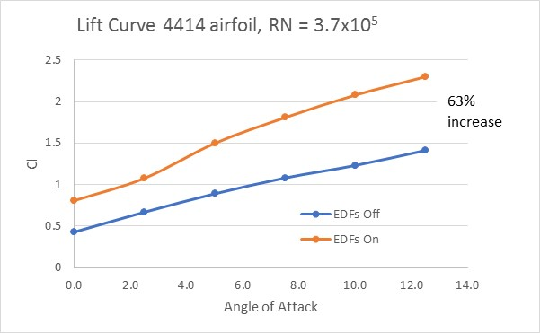

Slide 45
What next?
Finish getting JabirWatt test plane in the air.
Continued wind tunnel test to find near-optimal configuration.
By Fall 2018 tests on JabirWatt of six EDFs
IC engine operational
Instrumented to find thrust and lift contribution of EDFs
2019-2020 full complement of EDFs on JabirWatt and removal of IC engine.
Notes:
JabirWatt is a stock Jabiru that was involved in a ground “incident” and I rebuilt and registered as an EAB aircraft.

Slide 46
JabirWatt Comparison to Model
With full complement of EDFs, current batteries and two passengers:
Airframe weight fraction = 46%
Passenger weight fraction = 24%
Battery weight fraction = 30% (35 kwh)
JabirWatt

Slide 47
"It's the speed of the air,
not the airspeed.“
Willard Custer

Slide 48
For more details on IDEAL or this model
For a copy of “Comparing Electric Sky Taxi Visions”
https://www.davidullman.com/air-taxi-visions
For a paper developing the equations used in the model
Send email request to : ullman@davidullman.com
For a copy of “IDEAL: Integrated Distributed Electric-Augmented Lift”
https://www.davidullman.com/distributed-electric-propulsion
To discuss any of the topics presented here:
email - ullman@davidullman.com or call: 541-760-2338 (PST)

