Slide 1
Airspace Predictions for 2050
David G. Ullman
ullman@davidullman.com

Slide 2
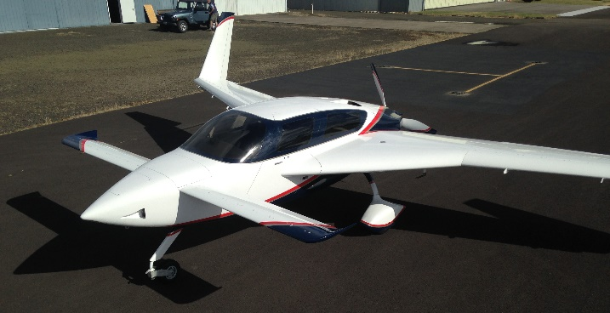
My background
BS and MS in aerospace engineering (1960s)
Transonic wind tunnel work for the Navy (1960s)
Air Force Flight Dynamics Lab (1970s)
PhD ME (1970s)
Emeritus Professor of product design (1980-2005)
Text “The Mechanical Design Process” 6th edition
Life Fellow ASME
Built two general aviation airplanes
Electric airplane design (2009- present)
Notes:
Research while Professor funded by NSF, DARPA, JPL and others
Taught by Wilbur Wright

Slide 3
Airplane Design Publications available at www.davidullman.com/aeronautics
2009: “Hear the Hum? An Electric Airplane May Be Coming Soon To An Airport Near You” KITPLANES
2010: “The Electric Powered Aircraft: Technical Challenges” EAA Experimenter.
2015: “Using Vortex Generators to Enhance Pusher Aircraft Cooling” KITPLANES
2017: “Comparing Electric Sky Taxi Visions”
With contributions from Pat Horgan of CubCrafters, Richard Ouellette of Boeing Commercial and Vincent Homer
May 2018 “Electric Air Vehicle Performance Prospects: Comparing eVTOL versus USTOL”, Keynote address at the Sustainable Aviation Symposium.
Notes:
Vince's work Funded by CCW

Slide 4
Basis for presentation
Findings of a Oregon State University course titled “The History of Aviation 1800 to 2200”
Current research and development directions
UBER Elevate
My keynote presentation from the Sustainable Aviation Symposium, SFO, May 2018
Other developments

Slide 5
Book written by Honors College students at Oregon State University (OSU) in class titled: “The History of Aviation 1800-2200”
Students are 19-22 years old, so their grandchildren will be aware in 2050.
Book available here, on Amazon and other sites
Price $15.00. Profits go to OSU Honors College.
Self published on CreateSpace.com

Slide 6
PREDICTIONS
“Det er vanskeligt at spaa,
især naar det gælder Fremtiden.”
It is difficult to make predictions,
especially about the future.
So, nothing I say will come true
and you wont agree with any of it anyway.

Slide 7
Book Chapters 1/2
Chapter 1 The Key to the Next Golden Age
The Future of Propulsion
Chapter 2 A Current Analysis of Aircraft Energy
The Future of Energy Storage and Efficiency
Chapter 3 Lighter, Faster, Stronger
The Future of Aviation Materials
Chapter 4 Who or What Will Be Your Pilot?
The Future of Autonomy
Chapter 5 Going Anew
The Future of Air Transport
Chapter 6 The Eyes in the Sky
The Future Development of Drones

Slide 8
Book Chapters 2/2
Chapter 7 Worker Bees of the Information Age
The Future Use of Drones
Chapter 8 Will We Ever be Able to Fly Everywhere?
The Future of Personal Air Vehicles
Chapter 9 Atmospheric Satellites
Bringing Space Down Near the Earth
Chapter 10 Aviation Regulation and Policy
Government Control of the Sky
Chapter 11 Managing Sky Congestion
The Future of Class B Airspace
Chapter 12 Society’s Influence on Aviation
The Drivers of Innovation
Chapter 13 What Will Your Grandchildren See?
Our Predictions

Slide 9
Organization of presentation
First, we will go through some easy predictions
Then we will focus on PAVs (Personal Air Vehicles) aka “Sky taxis”. Predicting where this is going is much harder.
Finally some overall predictions – the next 32 years will be exciting for aviation

Slide 10
Prediction: Our grandchildren will see more of what we have now.
Aviation changes very slowly.
Most general aviation aircraft look the same as they have for years.
In 2008, the average age of the general aviation fleet was nearly 50 years.
Commercial airplanes are all cigars and have been so since the DC-2 (introduced in 1936), over 80 years ago.

Slide 11
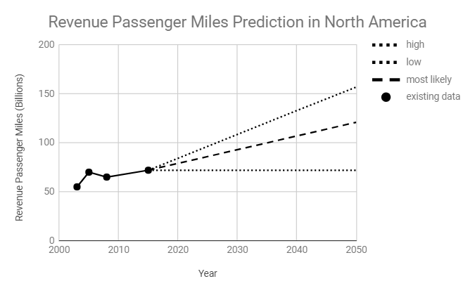
Prediction: Commercial Aviation will continue to expand.
Will require changes in regulations
Will require changes in infrastructure

Slide 12
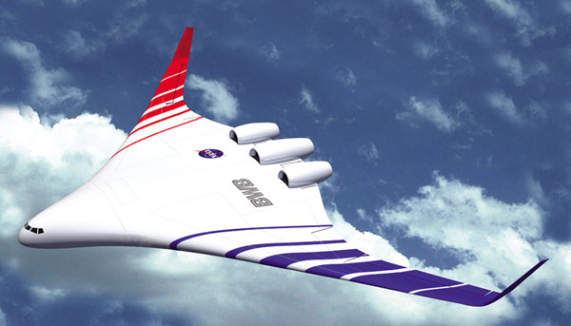
Prediction: Our grandchildren will see flying wings carrying passengers and cargo.
Will require changes in regulations
Will require changes in infrastructure

Slide 13
Our grandchildren will see more proactive and collaborative government regulation.
In the past FAA’s attitude has stymied innovation and they know it.
Moving from reactive to proactive.
FAA new Part 23 regulations are an example
Trying to change from “We’re not happy till your not happy” to “We will stay out of your way, just don’t hurt anybody”

Slide 14
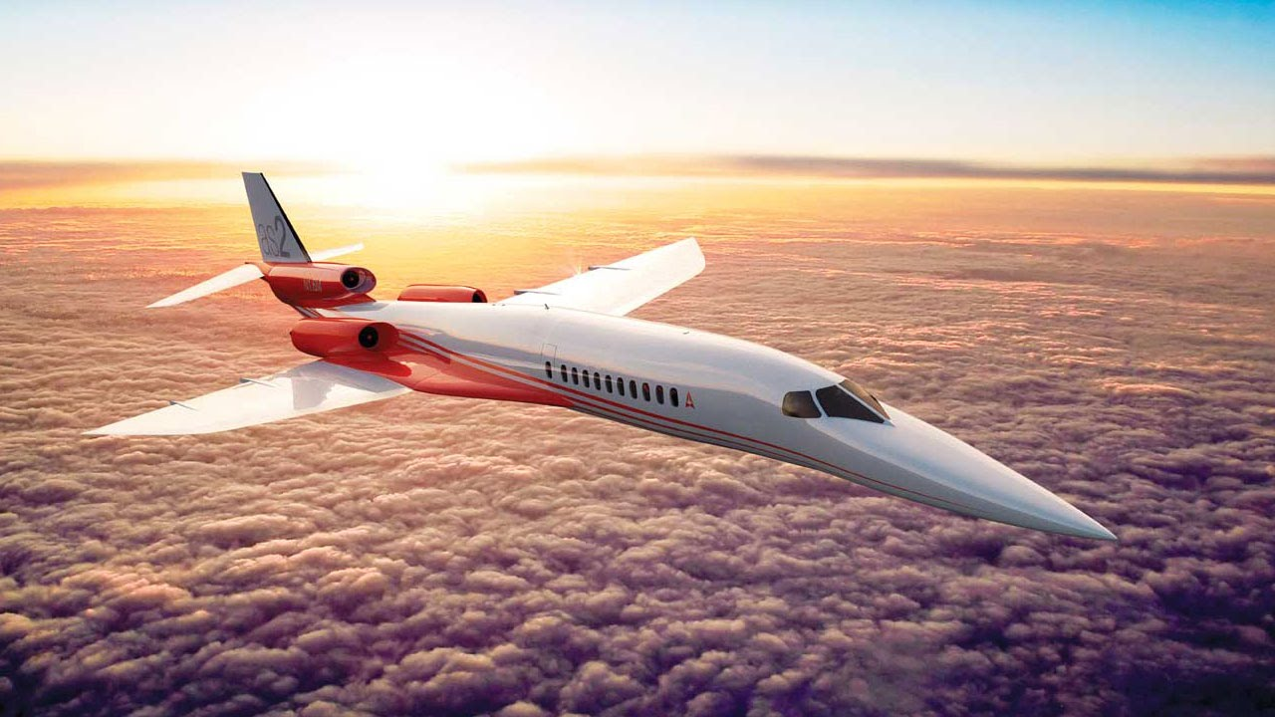
Prediction: Our Grandchildren will see supersonic airliners.
Concordes have come and gone.
With increasing demand for air travel and the value of people’s time, there are market drivers pushing for this capability.
Business jets then commercial.

Slide 15
Prediction: Our grandchildren will see drones, lots of drones.
The use of drones is currently evolving at a rapid rate
Mix of quadcopters, VTOL and conventional configurations.
Challenges.
Endurance
Air-space management
Autonomy
Landing zones
Privacy

Slide 16
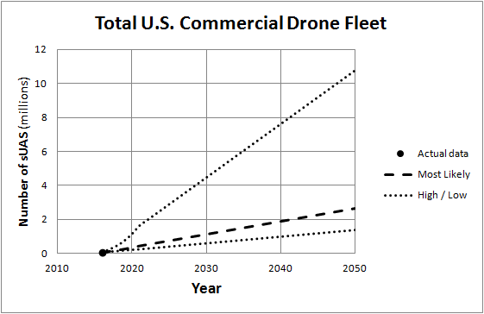

Slide 17
Prediction: Our grandchildren will see electric and hybrid aircraft.
In 2018, electric/hybrid airplanes are in their infancy.
While the large airplane manufacturers are seriously studying hybrid airliners, it is anticipated that acceptance will come first in general aviation.
The main drivers will be economy of flight and a desire to reduce pollution and noise.
Expect to see both manufacturers and hobbyists explore new configurations that optimize the use of electric propulsion.

Slide 18
The battery reality is limiting electric airplane development
Battery Type | Cost $ per Wh | Wh/kg | Wh/kg Deliverable
Lead-acid | $0.10 -0.17 | 25-41 | 22-37
NiMH | $0.99 | 50-60 | 45-54
NiCad | $1.50 | 39 | 35
Lithium-ion (2014 estimates) | $.15 – 1.00 | 110 -185 | 100-166
Tesla (pre 2017) | $.23 | 185 | 166
Tesla Model 3 (2170 format) | $.10 | 207 ?? | 207 ??
Theory max (Li) |  | 5,200 | 4700
Av gas | $0.14 | 14,000 | 3800

Slide 19
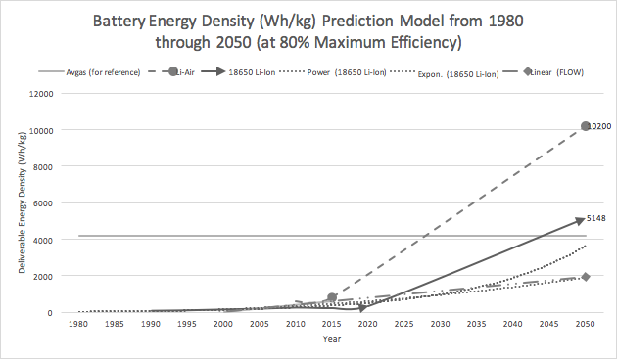

Slide 20
Future Lithium batteries
Battery energy density improving at 7- 8%/year
Battery energy density reality
Current 150 wh/kg
Near future 300 watt hr/kg
Far future 600 wh/kg
Other technologies
??

Slide 21
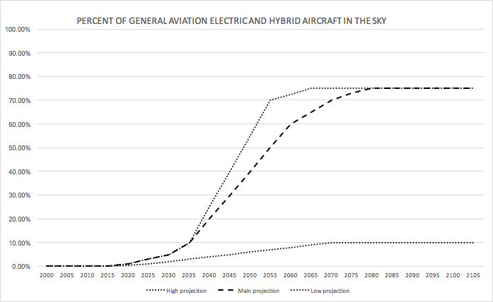

Slide 22
Prediction: Our grandchildren may see Personal Air Vehicles (PAVs).
Incentives
Relieve urban congestion
Provide air travel to more people
Emulate George Jetson
Many companies currently engaged in this endeavor.
Led by UBER and Dr. Brien Seeley (was Café Foundation, now Sustainable Aviation Foundation)

Slide 23
UBER eVTOL Mission Requirements
https://s3.amazonaws.com/uber-static/elevate/Summary+Mission+and+Requirements.pdf
VTOL with short duration hover
Safe vertical landing in the event of a critical failure
Noise – 15 db quietter than existing light helicopters or 70 db at 500 ft (vaccum cleaner is about 70db)
Batteries at 300wh/kg – no hybrid
Charging 5-15 min up to 600kw
Pilot in each vehicle moving to autonomous

Slide 24
UBER eVTOL Mission Requirements
https://s3.amazonaws.com/uber-static/elevate/Summary+Mission+and+Requirements.pdf
3 -4 passenger seats (960 - 1,100lb max payload)
Max wt 7000 lbs
Ground taxi up to 300’ at 5 ft/sec
< 45’ (13.7m) max dimension
Range 60 miles (100km - 52 Nautical miles)
Reserve – 6 miles (10km)
Cruise 150mph (130kts) at 1000ft AGL

Slide 25
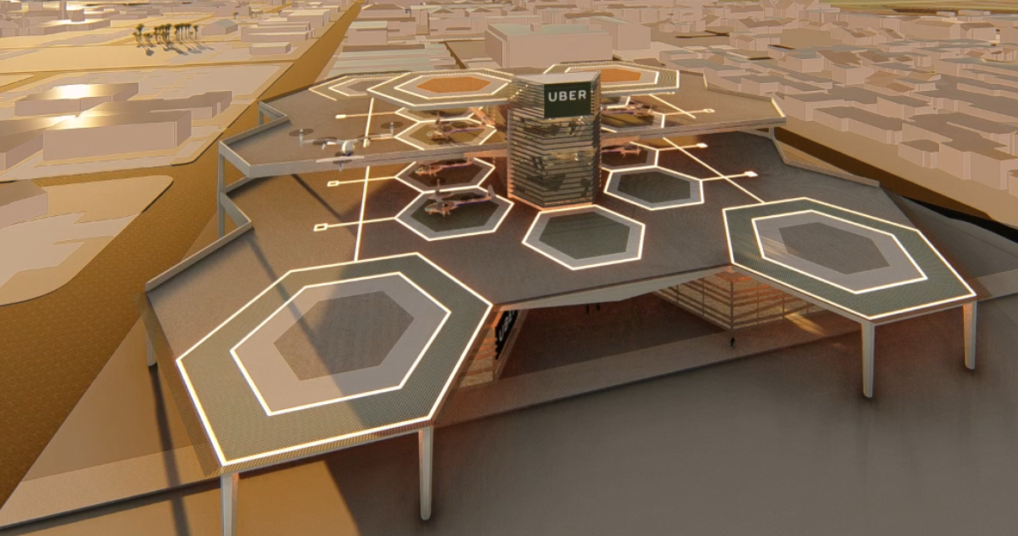

Slide 26
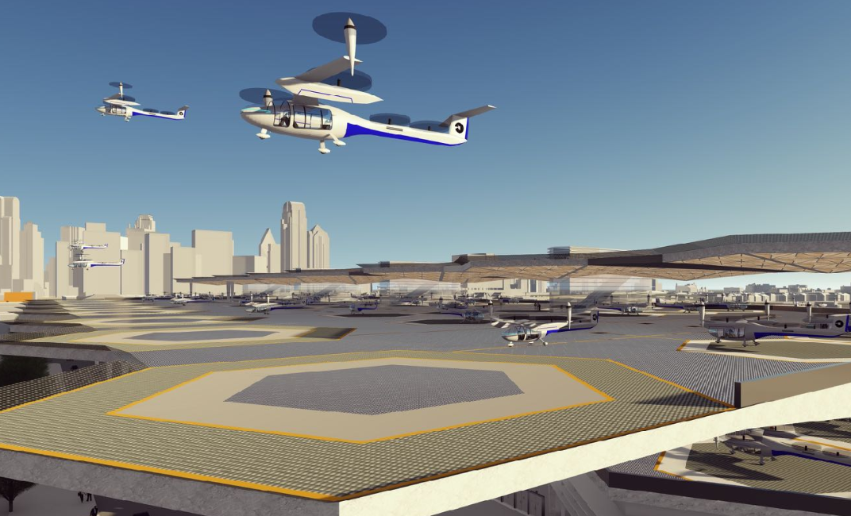

Slide 27
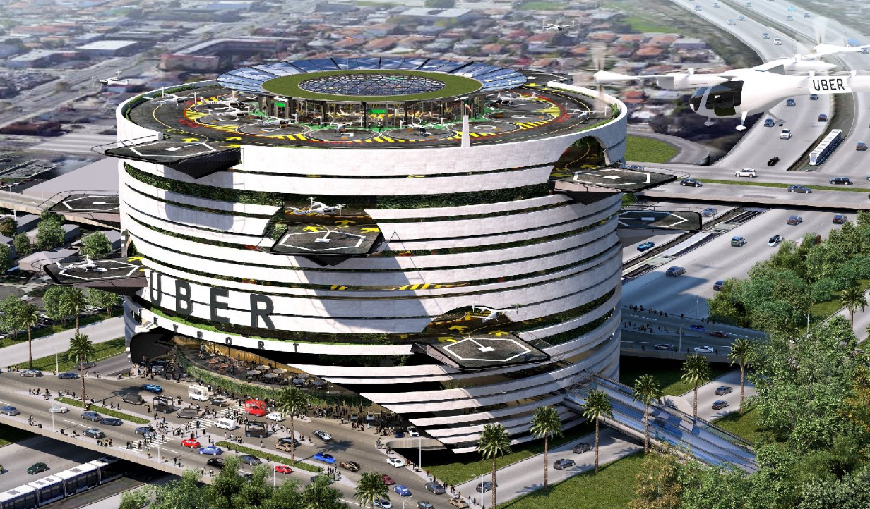

Slide 28
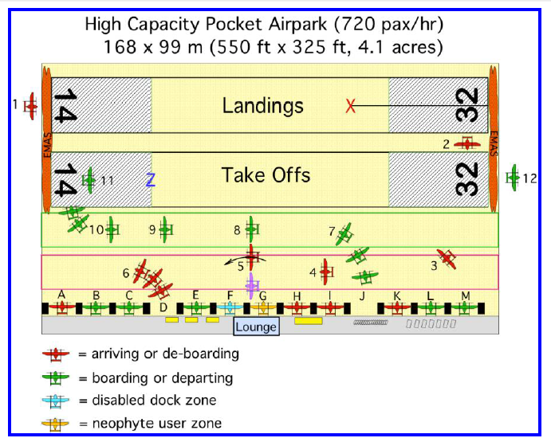

Slide 29
Personal Air Vehicles Technical Terminology
Dependent on Distributed Electric Propulsion (DEP).
DEP enables the evolution of Propulsion Airframe Interaction (PAI).
PAVs may be VTOL, rotor-craft or USTOL (Ultra STOL).

Slide 30
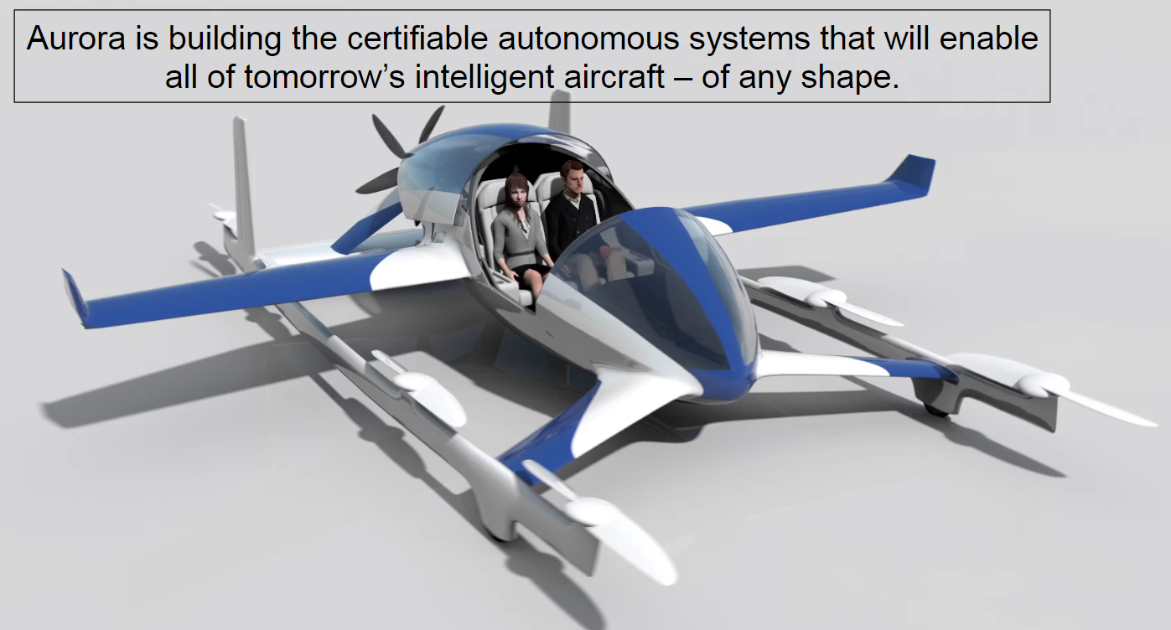
Airframe Manufactures are taking this seriously
“Bell Helicopter” has changed its name to “Bell”
Aurora (a Boeing Company)

Slide 31
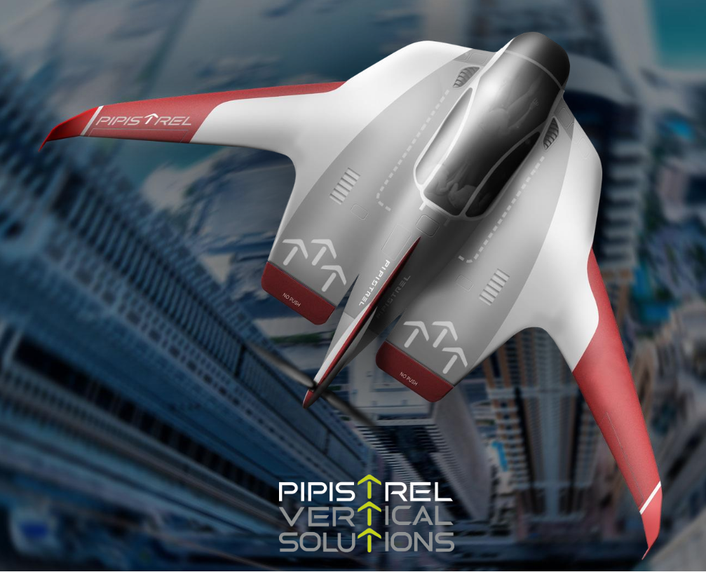
Pipistrel Vertical Solutions

Slide 32
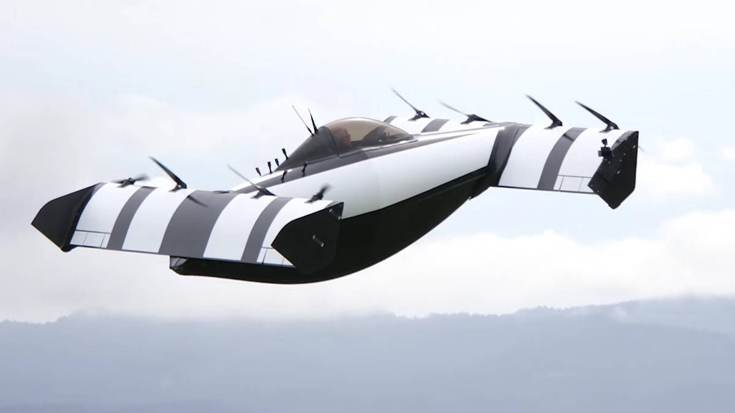
Black fly

Slide 33
Roll Royce

Slide 34
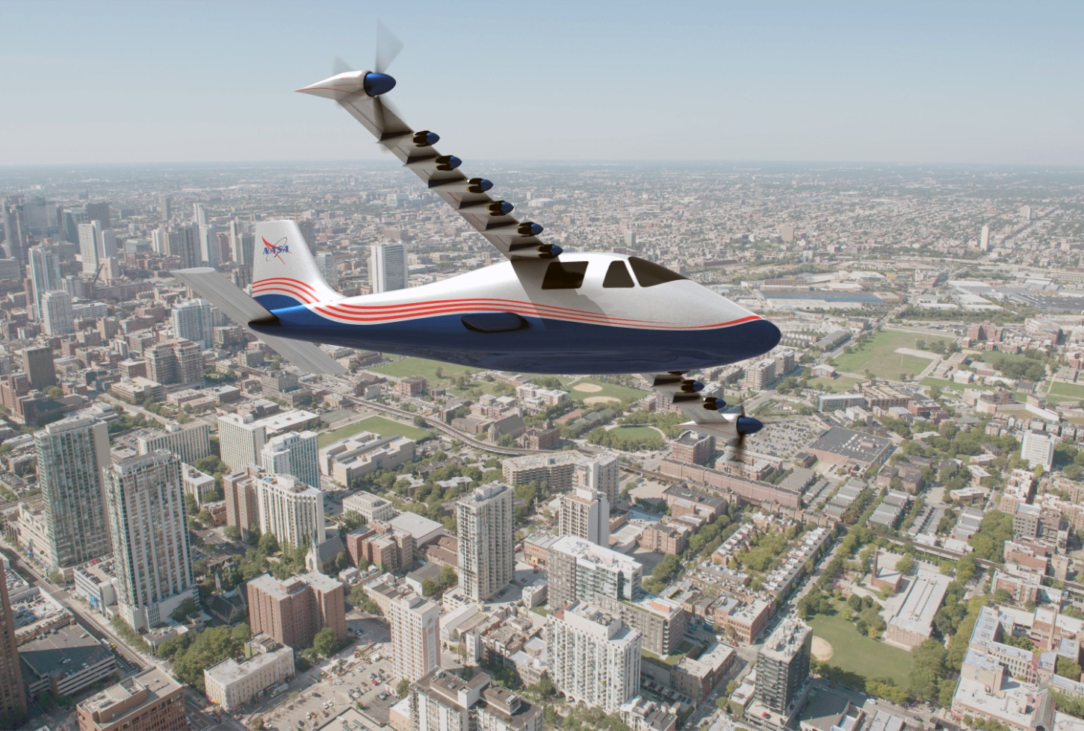
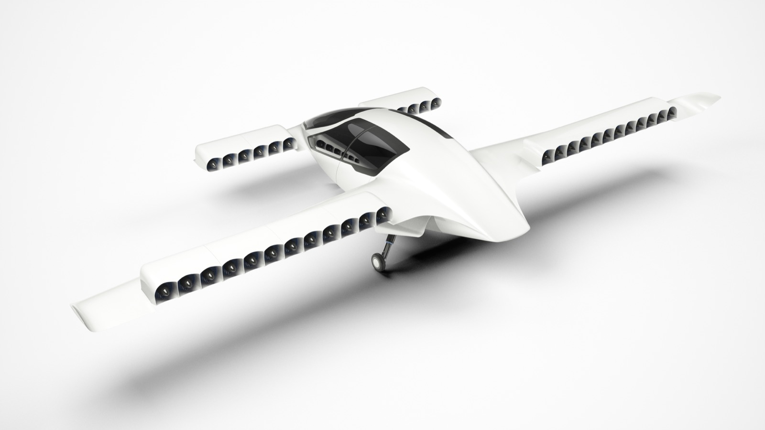
Distributed Electric Propulsion (DEP) with Propulsion Airframe Interaction (PAI).
X-57 Maxwell
Lilium VTOL Jet

Slide 35
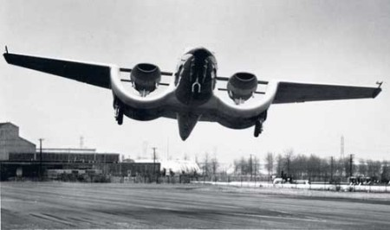
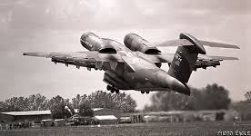
Ultra Short Take-Off and Landing (USTOL): winged aircraft that uses Distributed Electric Propulsion (DEP) to create Propulsion Airframe Interaction (PAI) enabling short distance take offs and landings while providing very efficient cruise potential. Descended from the Custer Channel Wing, Boeing YC-14 and others
Notes:
Custer started in the 1930s.

Slide 36
IDEAL, Integrated Distributed Electric-Augmented Lift or IDEAL

Slide 37
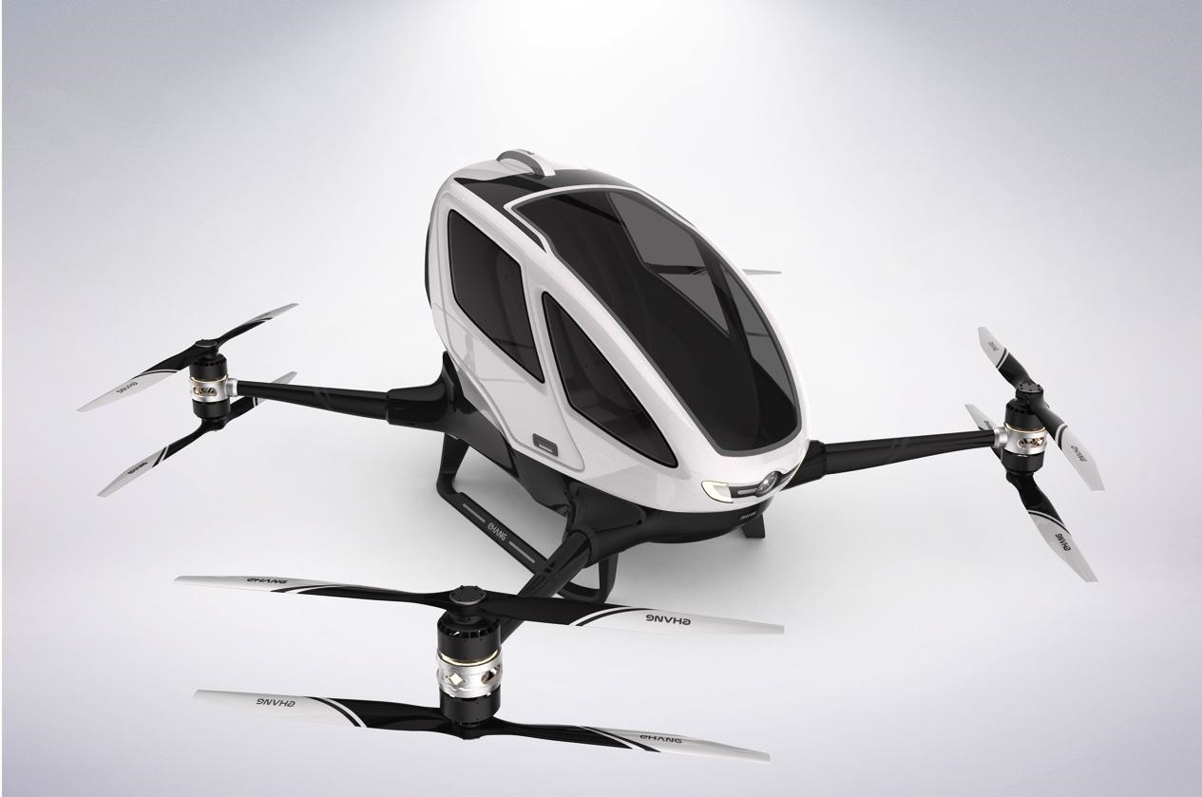
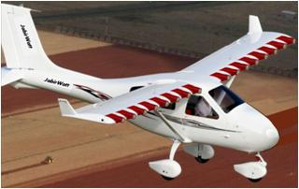
Classes of Aircraft Considered
eVTOL
USTOL
Rotor-Craft

Slide 38
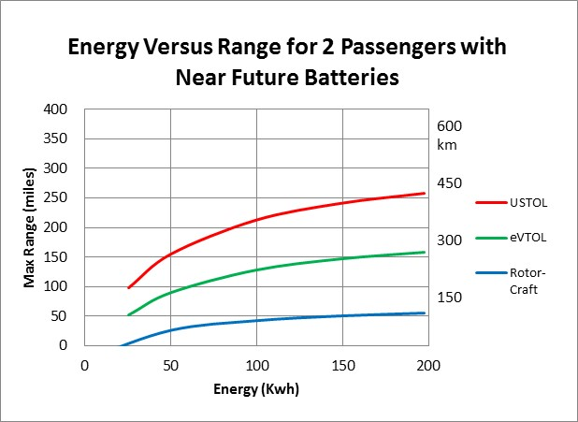
300 Kwh near future battery requires 1826 lb (830kg) battery in a 5000 lb (2270kg) machine
300 Kwh near future battery will cost an estimated $20,000

Slide 39
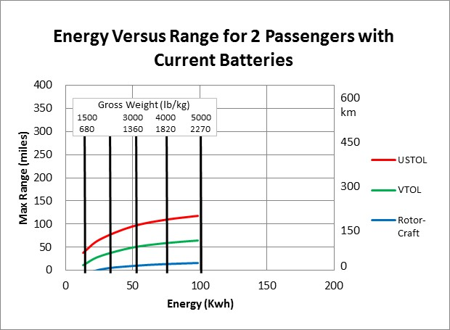
Tesla Model S with large battery
Notes:
Rotor-craft have a range of 15 miles (24 km) Graph stops at 100 kwh as this is a 5000 lb machine regardless of class.
eVTOLs will have range of less than 65 miles (100km) with 5000 lb (2272 kg) aircraft and require very high thrust and power.
USTOLs can achieve 116 miles (186 km).

Slide 40
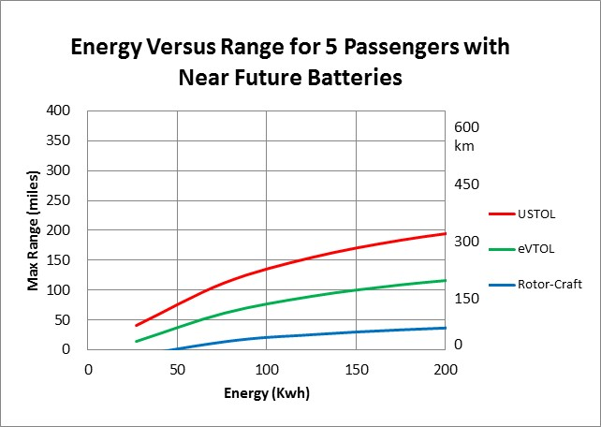
300 Kwh near future battery requires 1826 lb (830kg) battery in a 6500 lb (3000kg) machine

Slide 41
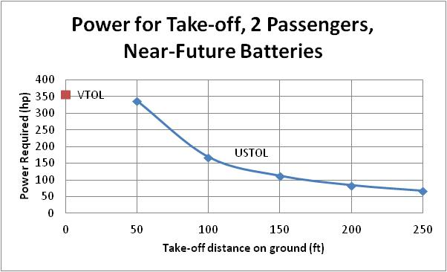
USTOL has nearly twice the range as the comparable eVTOL

Slide 42
Takeaway #1
Rotor-craft may evolve into usable short distance PAVs, but regardless of battery evolution, they will always be severely range limited unless they go hybrid.

Slide 43
Takeaway #2
eVTOLs can be developed into short or mid-range vehicles, but they will be large, may require hybrid systems and high power.

Slide 44
Takeaway #3
USTOLs have the potential to be a good mid to long range electric air vehicle solution.
Regardless of mission USTOLs require about 1/3 the energy as eVTOLs!
Depending on take-off distance, USTOLs require much less power than eVTOLs.
Notes:
Where the UBER sidewalk ends

Slide 45
Takeaway #4
PAI (Propulsion Airframe Interaction) is under-studied in the current PAV frenzy. Most rotor-craft and eVTOLs use brute force where there might be more subtle solutions leading to great energy savings and power/noise reduction.
The IDEAL project uses DEP with EDFs leveraging PAI to achieve USTOL.
Notes:
Lillium is an exception

Slide 46
Magic or Divine intervention needed for PAV Success
Battery energy density doubled
VTOL aircraft developed
Noise issues abated
Pilots found
Regulations developed
Societal acceptance
Noise
Autonomy
Safety perception

Slide 47
Prediction: Our grandchildren will see, at the very least, limited implementation of Personal Air Vehicles. (PAVs).
The savings that PAVs could provide make the infrastructure changes worth the cost.
VTOL type aircraft are the most likely to become the standard for urban PAVs.
USTOL aircraft may also evolve for inter-urban needs.
With many companies currently engaged in this endeavor, people are going to be increasingly interested in this mode of transportation, leading to an increase in acceptance.
While it has been historically impossible to provide a car like experience in a flying vehicle, technology breakthroughs are changing that.

Slide 48
Prediction: Our grandchildren will see autonomous airplanes.
Drones fly autonomously for many applications.
Commercial aircraft can already take off, navigate, and land without human aid.
With a current and increasing shortage of pilots there is an incentive to automate what we can.
Personal Air Vehicles (PAVs) demand autonomy

Slide 49
Prediction: Our grandchildren will see a change in infrastructure.
With the evolution of drones, PAVS, air satellites and other new types of aircraft, there will also need to be an evolution in the infrastructure to support them.
Droneports, vertiports, miniports, bigger airports and the like will co-develop. It is very unclear what this will look like or how many there will be.
UBER and others have gone as far as suggesting air taxi vertiports in highway clover leafs.
Many have suggested air-taxi terminals on roof tops or in neighborhoods.

Slide 50
Prediction: Our grandchildren will see more airplanes in the sky.
With the maturation of drones, introduction of sky-taxis (PAVs) and atmospheric satellites, and the continuing increase in commercial air traffic, the skies will become more crowded.
The future of atmospheric aviation looks bright.
The next thirty five years will see more-of-the-same mixed with radically new aircraft.

Slide 51
Prediction: Our grandchildren may see bluer skies.
Airplanes will be cleaner leading to less emissions and cleaner skies.
Drones will be electric with the electricity coming from clean sources.
Commercial transportation will continue to grow, but at the same time get cleaner and more efficient.
GA will be a mix of IC, hybrids and electrics.
Some GA aircraft flying now will still be in the air.
Personal Air Vehicles (PAVs) or air-taxis will be common and may be electric or hybrid.

Slide 52
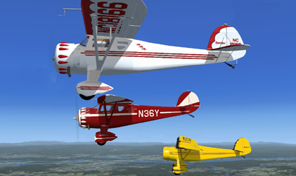
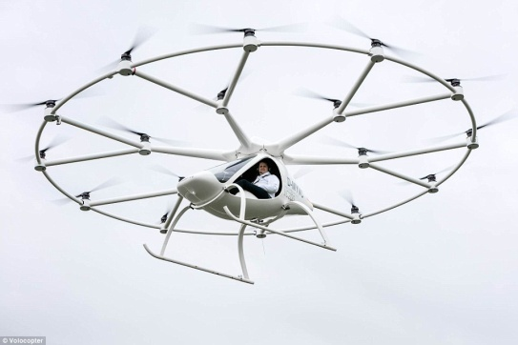
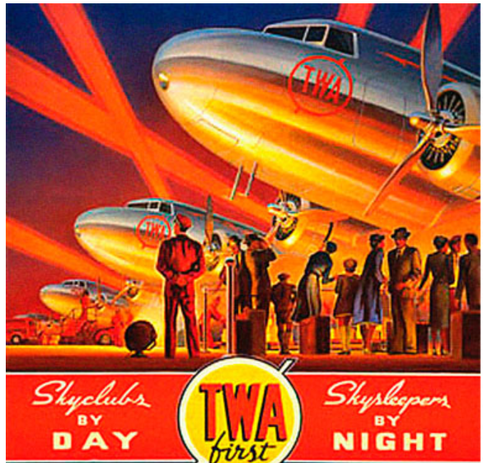
We are Entering the Second Golden Age of Aviation
2015 – 2050
1920s – 30s

Slide 53
For details on how to publish a book written by students, go to:
www.davidullman.com/aeronautics/WWGS-notes.pdf
Send your questions, comments, disagreements or statements of “hogwash” to:
ullman@davidullman.com
541-760-2338
www.davidullman.com

